Slide 1
Retail Store Sales Analytics Project
Navitha.n

Slide 2
Project overview:
Objective:
The objective of this project is to clean and analyze retail salaes data and create an interactive dashboard to identify sales trends , customer prefrerence , and business insights.
Tools Used:
Python(Pandas)
Jupyter Notebook
Power BI
Excel

Slide 3
DAtaset Information:
Source : Retail Store sales dataset(12575 Rows and 11 Columns)
Features:
Transaction ID
Customer ID
Category
Item
Price Per Unit
Quantity
Total Spent
Payment Method
Location
Transaction Date
Discount Applied

Slide 4
Issues Identify:
Missing Values present,
Invalid Values(0),
Inconsistent data types,
Need Meaningful insights

Slide 5
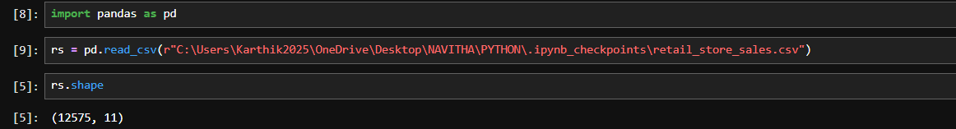
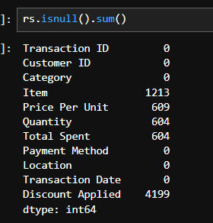
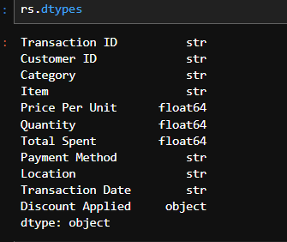
Data Cleaning:
1.Loaded dataset using Pandas:
2.Checking Null Values:
3.Checking Datatypes:

Slide 6
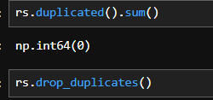
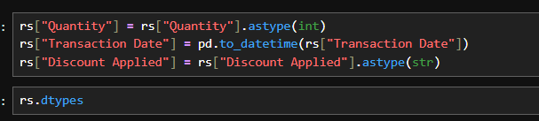
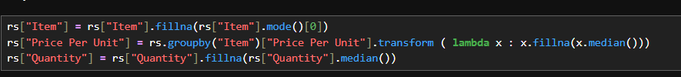
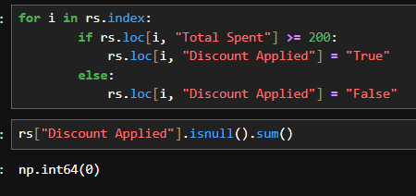
4.Remove Duplicates:
6.Changing datatypes:
5.Replace Invalid Null values:

Slide 7
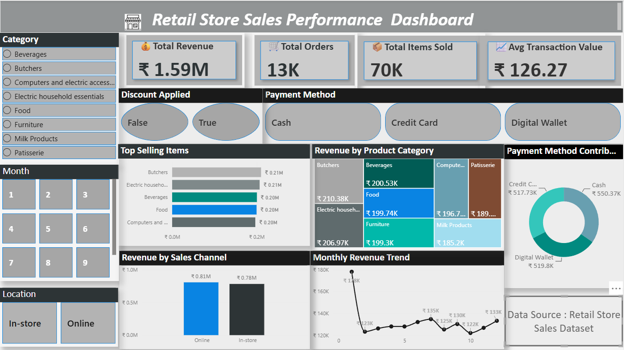
DASHBOARD:

Slide 8
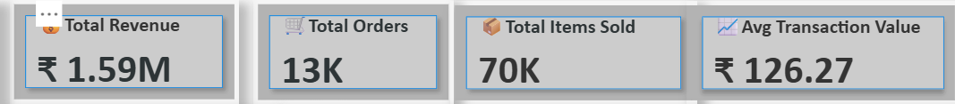
KPI cards:
Total Revenue = Total Revenue reached 1.59M
Total Orders = The Stote Processed 13K orders successfully.
Total Items Sold =More then 70K items were sold.
Average Transaction Values =Customers spent $126.27 on average per transaction.

Slide 9
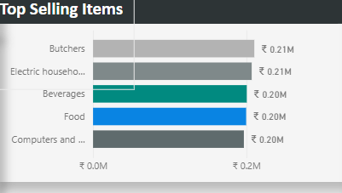
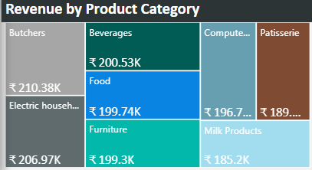
Visuals:
Butchers and Electronic Household Essential category generated the highest revenue
Food and Beverages also contributed significantly.
Top Selling items accounted for a major share of sales.
Category-wise analysis helps identify profitable product segments.

Slide 10
Business Insights:
Total revenue reached at $1.59M, indicated strong overall sales performance.
Butchers category contributed the highest revenue,making it the best-performing product category.
Online sales(0.81M) slighly higher than In-store sales(0.78M),showing the impartance of digital sales chennal.
Cash was the most prefered payment method,followed closely by Credit Card and Digital Wallet.
Top-selling items generated a significant share of total revenue,highlighting key products driving business growth.
Monthly revenue remained relatively stable,with a few peak periods indicating higher customer demand.

Slide 11
Business Recommentations:
Focus more on high-performing categories.
Increase promotions for low-performing categories.
Strengthen online sales chaneels.
Encourage digital payments through offers and rewards.
Maintain sufficiant invertory fot top-selling products.

Slide 12
Chellanges:
Handling missing and invalid values in the dataset.
Converting date columns into the correct format.
Create a Total amount column based on discount applied column.
Cleaning and preparing data for analysis.
Choosing the right visuals to represent business insights.
Desiging a clean and interactive Power BI dashboard.
Learings:
Gained hands-on experience in data cleaning using Python(pandas).
Learned how to handle missing values and data type conversions.
Improved skills in data transformation and preparation.
Created KPIs and interactive visualizations in PowerBI.
Developed the ability to devire business insights from data.

Slide 13
Conclusion:
Successfully cleaned and analyzed retail store sales dats using Python and PowerBI .The dashboard provided valuable insights into revenue, product performance ,sales channels, and customer purchasing behaviour, helping supporrt data-driven business decisions.

